Slide 1
Lesson 10

Slide 2
01
Vocabulary
02
Listening
Table of content:
Shopping
Part 2: Questions and responses (2)

Slide 3
Vocabulary
SHOPPING

Slide 4
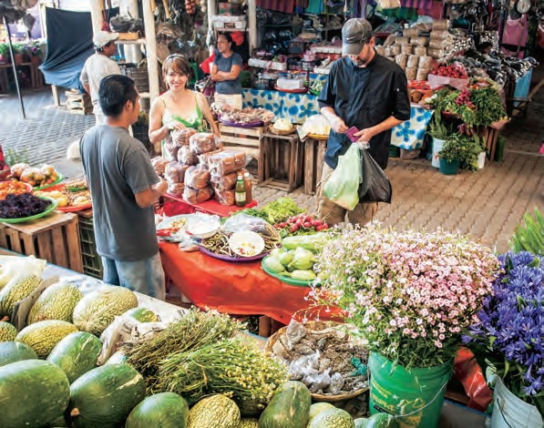
Bargain /ˈbɑːrɡən/
V., to negotiate; N., an advantageous purchase
a. She bargained for over an hour, finally reducing the price by half. b. Lois compared the sweaters carefully to determine which was a better bargain.

Slide 5
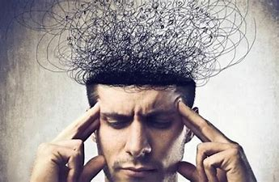
bear /ber/
v., to have tolerance for; to endure
a. Moya doesn’t like crowds so she cannot bear to shop during the holiday rush. b. If you can bear with me, I’d like to stop in one more store.

Slide 6
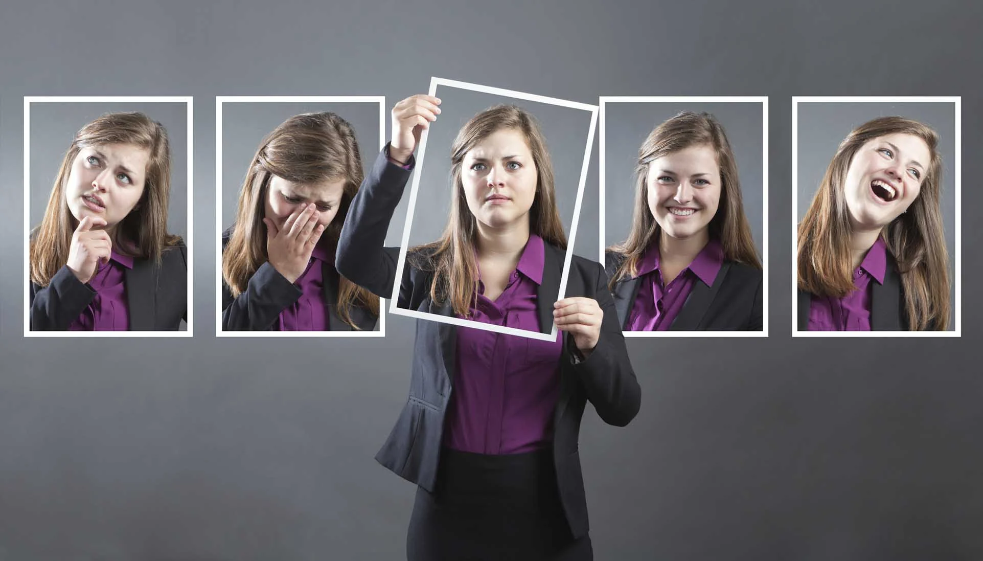
Behavior /bɪˈheɪvjər/
n., the manner of one’s actions
a. Anna is conducting a survey on whether consumer behavior differs between men and women. b. Suspicious behavior in a department store will draw the attention of the security guards.

Slide 7
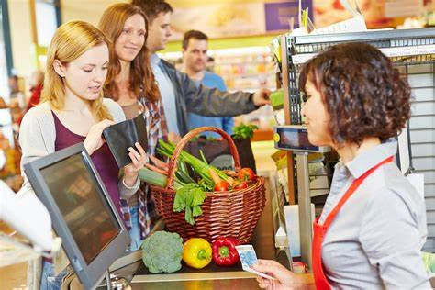
Checkout /ˈtʃekaʊt/ (n) the act, time, or place of checking out, as at a hotel, library, or supermarket.
a. The line at this checkout is too long, so let’s look for another. b. Get in the checkout line now and I’ll join you with the last items.

Slide 8
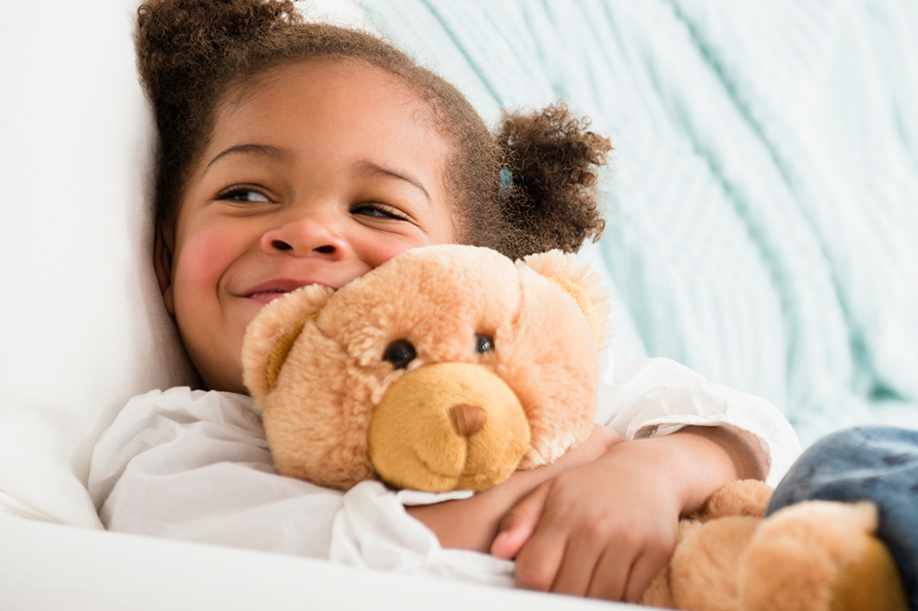
Comfort /ˈkʌmfərt/ v. to calm somebody; n.; a condition or feeling of pleasure ease, well-being; and contentment
a. Comfort yourself with a down quilt this winter. b. I like to dress for comfort if I’m spending the day shopping.

Slide 9

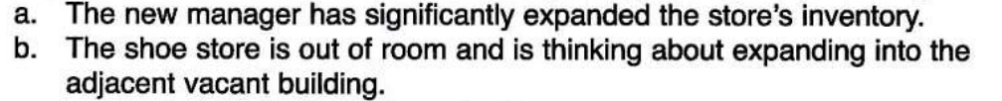
Expand /ɪkˈspænd/ V., to increase the size, volume, quantity or scope; to enlarge

Slide 10
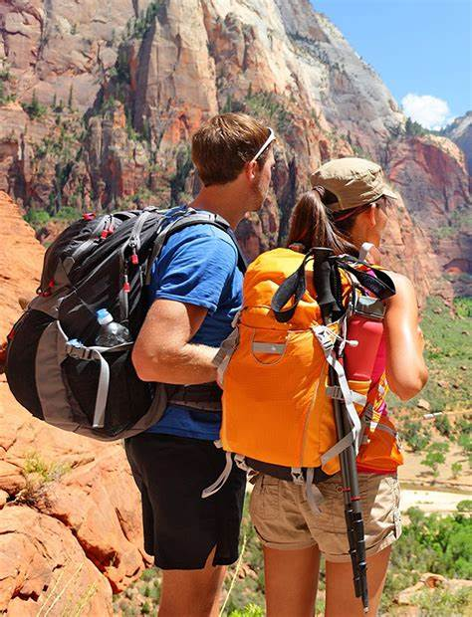
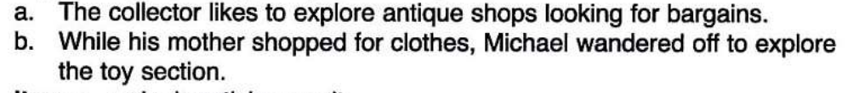
Explore /ɪkˈsplɔːr/ V., to investigate systematically

Slide 11
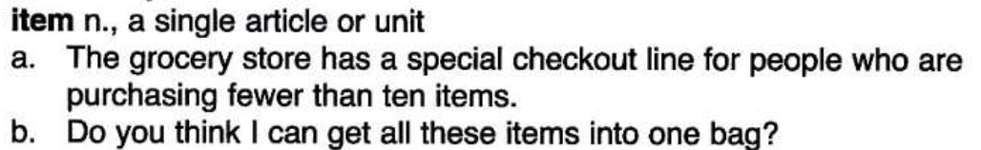
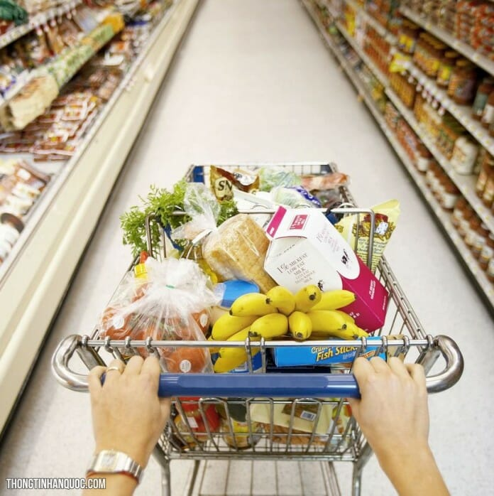
/ˈaɪtəm/

Slide 12
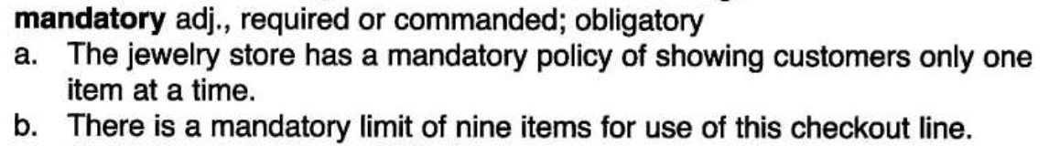
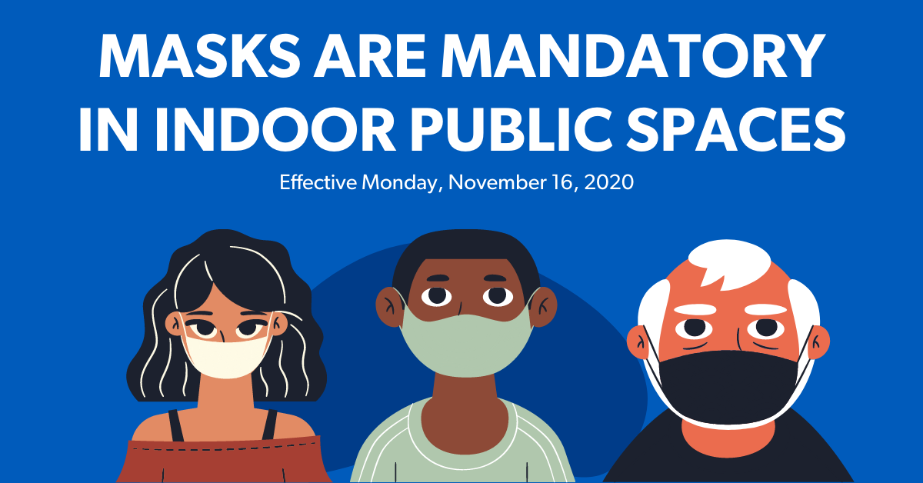
/ˈmændətɔːri/

Slide 13
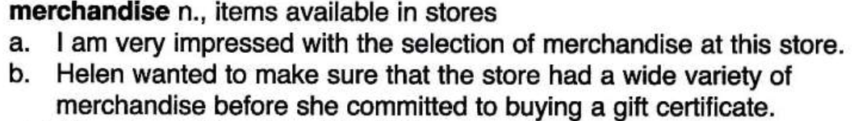
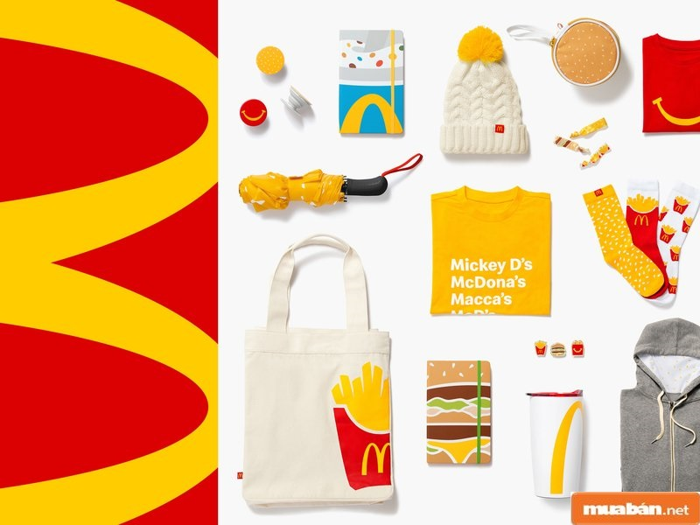
/ˈmɜːrtʃəndaɪz/

Slide 14
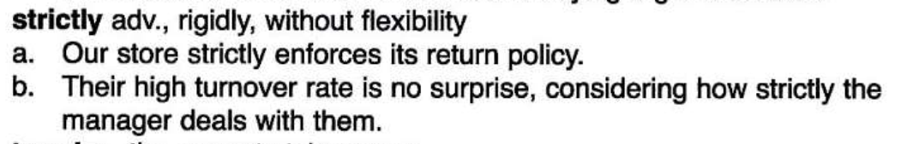

/ˈstrɪktli/

Slide 15
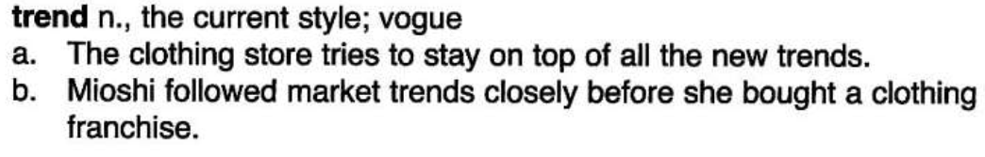

/trend/

Slide 16

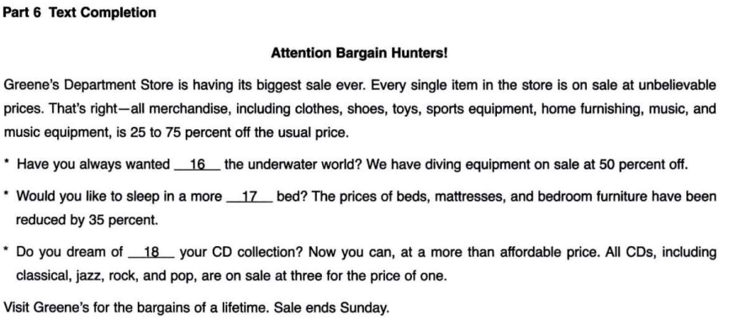
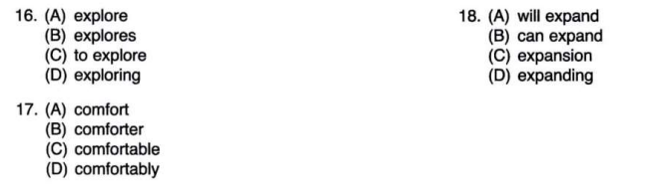

Slide 17


Slide 18
02
LISTENING

Slide 19
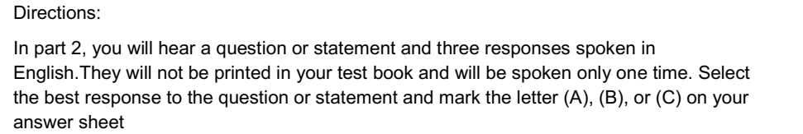
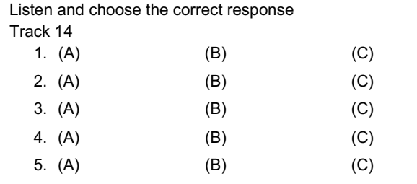

Listening: Questions and responses (2)

Slide 20
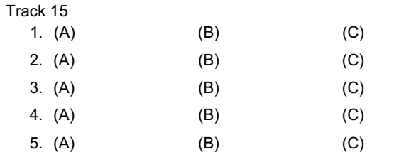
Listening: Questions and responses (2)

Slide 21
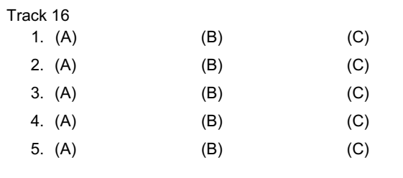
Listening: Questions and responses (2)

